Slide 1
A Project On Customer Churn Prediction By
Name | Email | Country | College/Company | Specialization
Fabian Umeh | Fabianumeh335@gmail.com | UK | Teesside University | Data Science
Rukevwe Ovuowo | rukevwe10@gmail.com | Nigeria | GBG Data science Academy | Data Science
Olutayo Oladeinbo | oladeinboolutayo@yahoo.com | UK | Teesside University | Data Science

Slide 2
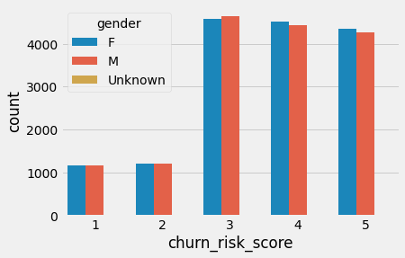
Both male and female customers have nearly equal rates of churn risk in the data group collected

Slide 3
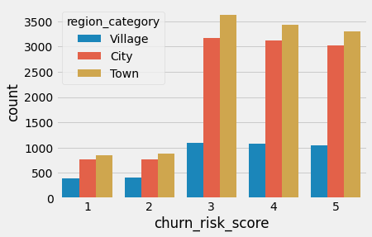
There are lesser chances of customers from the village to churn when compared to customers from cities and towns

Slide 4
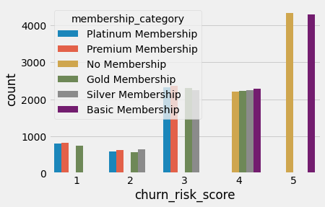
Customers with basic or no membership category shows the highest churn risk score

Slide 5
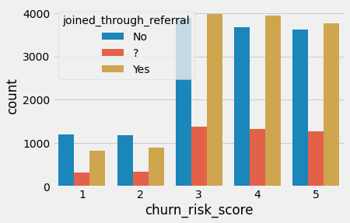
The data collected for shows no meaningful difference I churn risk between customers who joined through referrals and those who did not

Slide 6
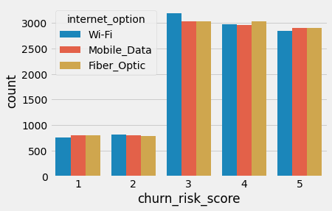
Internet options does not reveal any meaningful bearing on customer churn risks

Slide 7
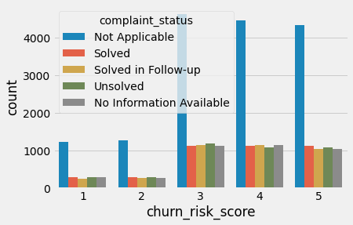
Most complaints made by customers are usually ‘Not applicable’

